Slide 1
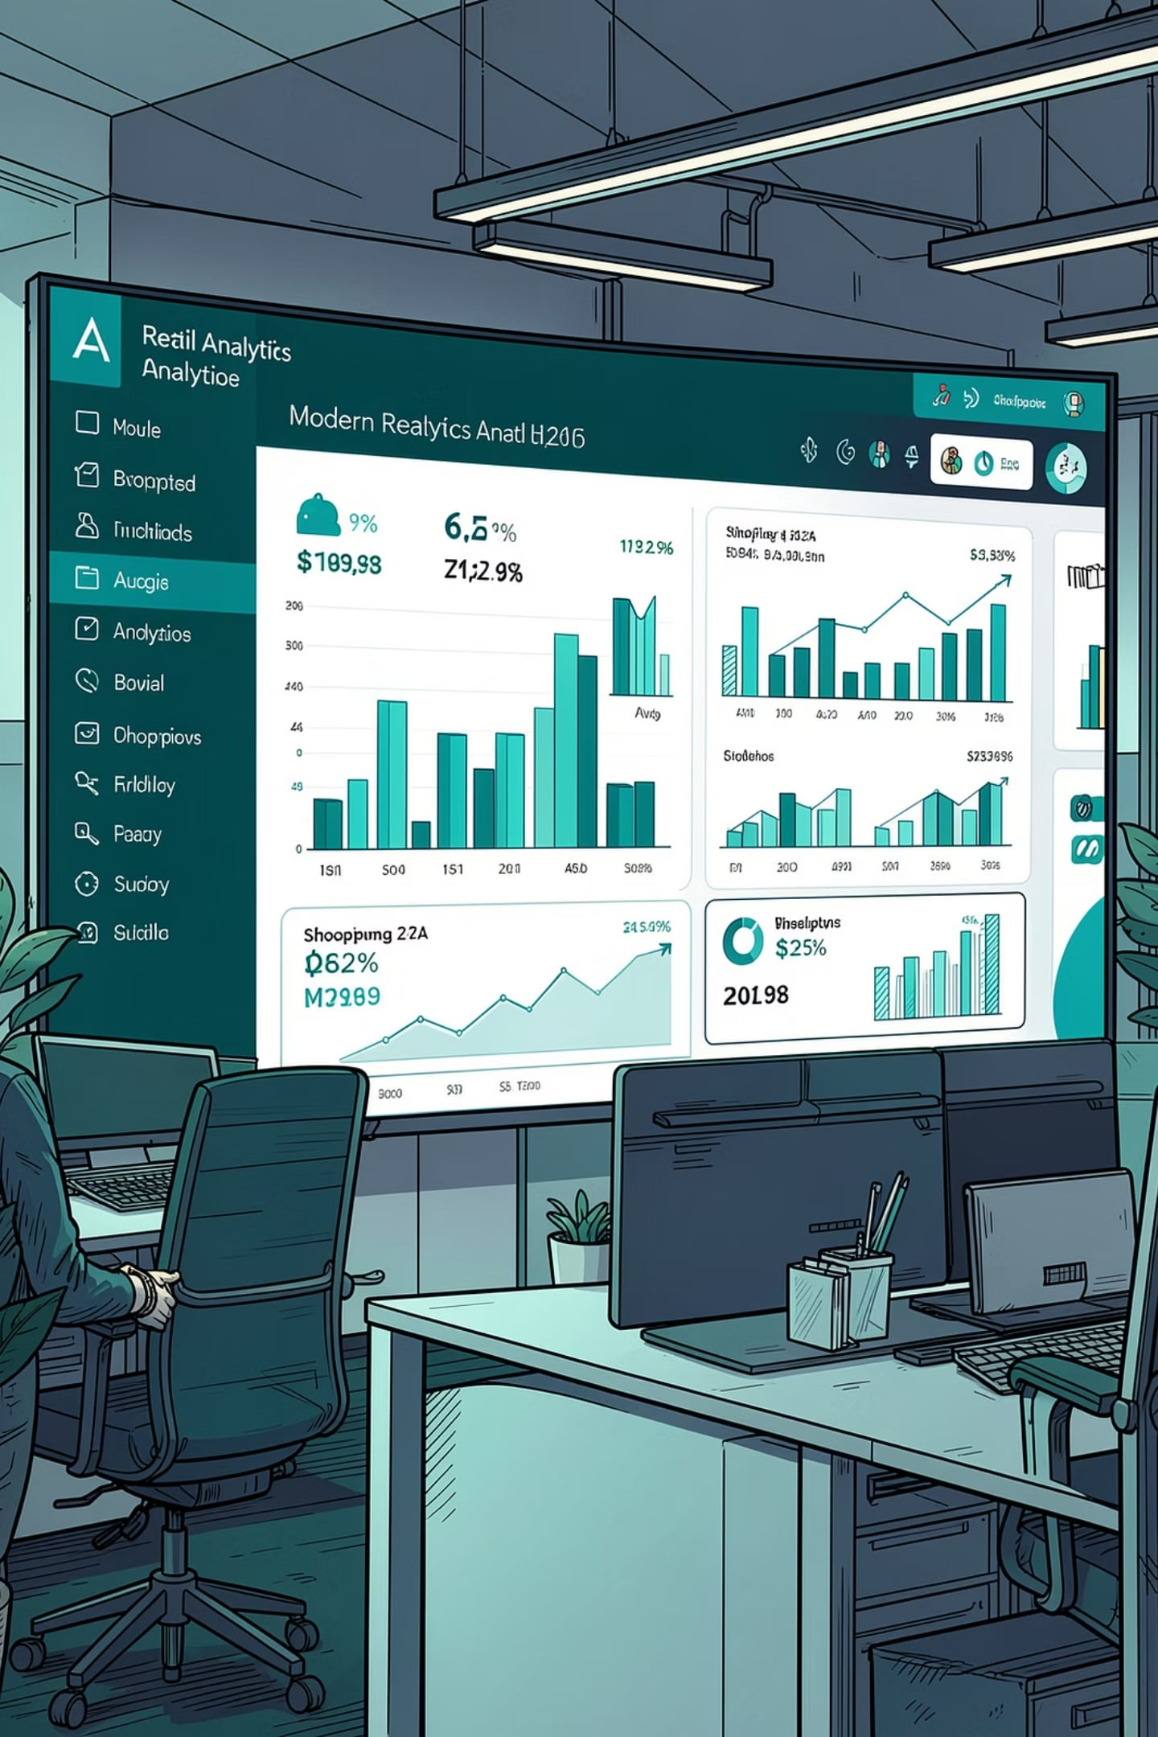
PYTHON
SQL
POWER BI
Customer Shopping Behaviour Analysis
An end-to-end data analytics project examining how demographics, product categories, discounts, and sales channels shape shopping behavior across 3,900 customer transactions.
Prepared by: Aditya · July 2026

Slide 2
EXECUTIVE SUMMARY
The Big Picture
$233K
$59.76
Total Revenue
Avg. Basket
Across 3,900 transactions
Per customer transaction
3.75
76%
Avg. Satisfaction
Clothing + Accessories
Out of 5.0
Of total revenue share
Per-customer spending and satisfaction are remarkably consistent across age, gender, subscription status, and payment method — revenue differences are driven by segment size, not by how much any individual customer spends.

Slide 3

SECTION 1–2
Business Problem & Data Preparation
Management wanted to know which factors — discounts, reviews, seasonality, or payment preferences — actually drive consumer decisions and repeat purchases.
01
Data Preparation
Clean & transform raw data in Python
02
Data Analysis
Structure & query in SQL for insights
03
Visualization
Build interactive Power BI dashboard
04
Report & Repository
Summarize findings & house all files on GitHub

Slide 4
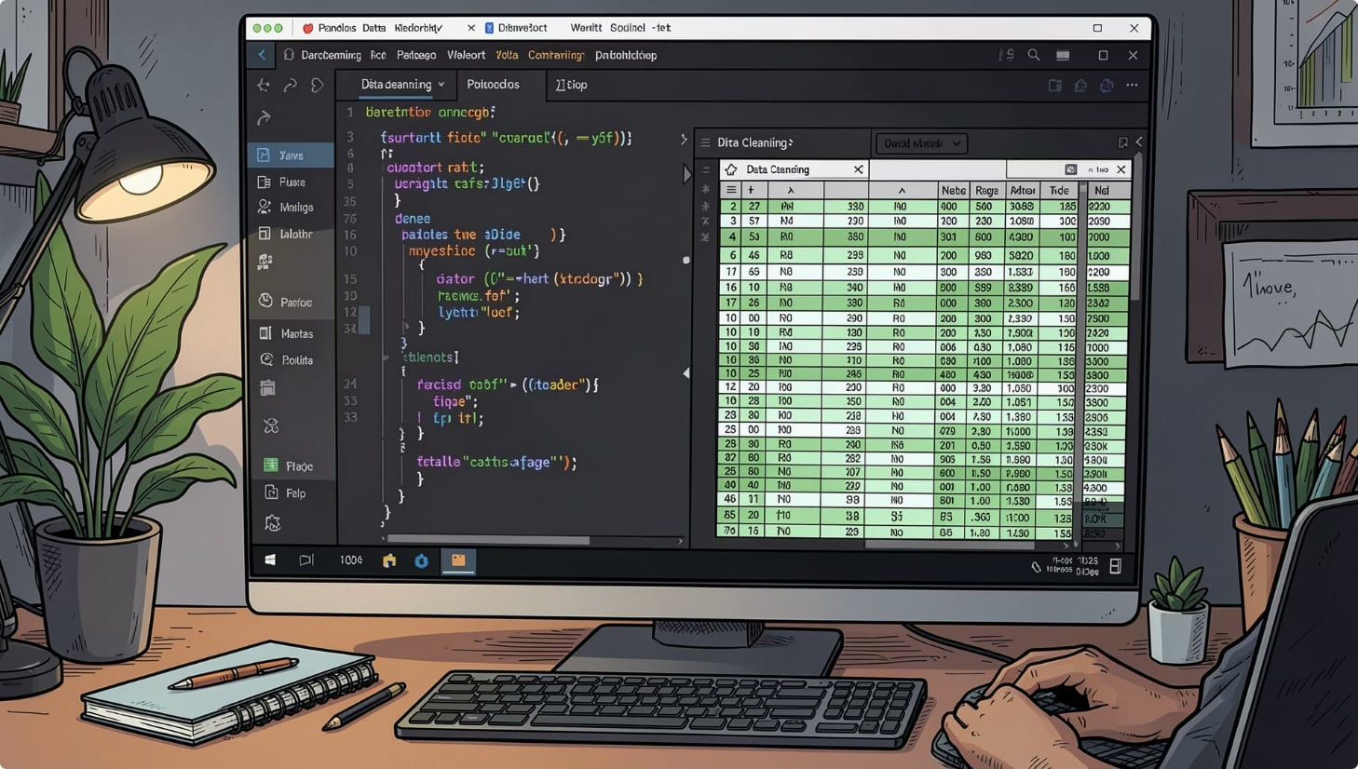
SECTION 2
Cleaning & Feature Engineering
Key Cleaning Steps
Missing values: 37 Review Ratings imputed with category-level median — resistant to outliers
Column names: Standardized to lower_snake_case for reliable SQL access
Redundant column: Dropped promo_code_used — identical to discount_applied in every row
New Features
age_group: Binned into Young Adult (≤25), Adult (26–40), Middle-Aged (41–60), Senior (61+)
purchase_frequency_days: Mapped text frequency to numeric day interval for loyalty analysis
Final dataset: 3,900 rows × 19 columns, loaded into a SQL database for structured querying.

Slide 5

SECTION 3.1
Customer Segments by Age Group
Basket size and satisfaction are remarkably flat across age cohorts — within a $1.14 band.
Middle-Aged is the largest cohort by headcount (1,503), while Young Adults post the highest average purchase and rating despite being the smallest group.
Age Group
Customers
Avg. Purchase
Avg. Rating
Avg. Prior Purchases
Young Adult
571
$60.65
3.82
24.6
Senior
723
$59.70
3.76
26.1
Adult
1,103
$59.69
3.75
25.0
Revenue differences are driven by segment size, not by per-customer spend.
Middle-Aged
1,503
$59.51
3.72
25.5

Slide 6
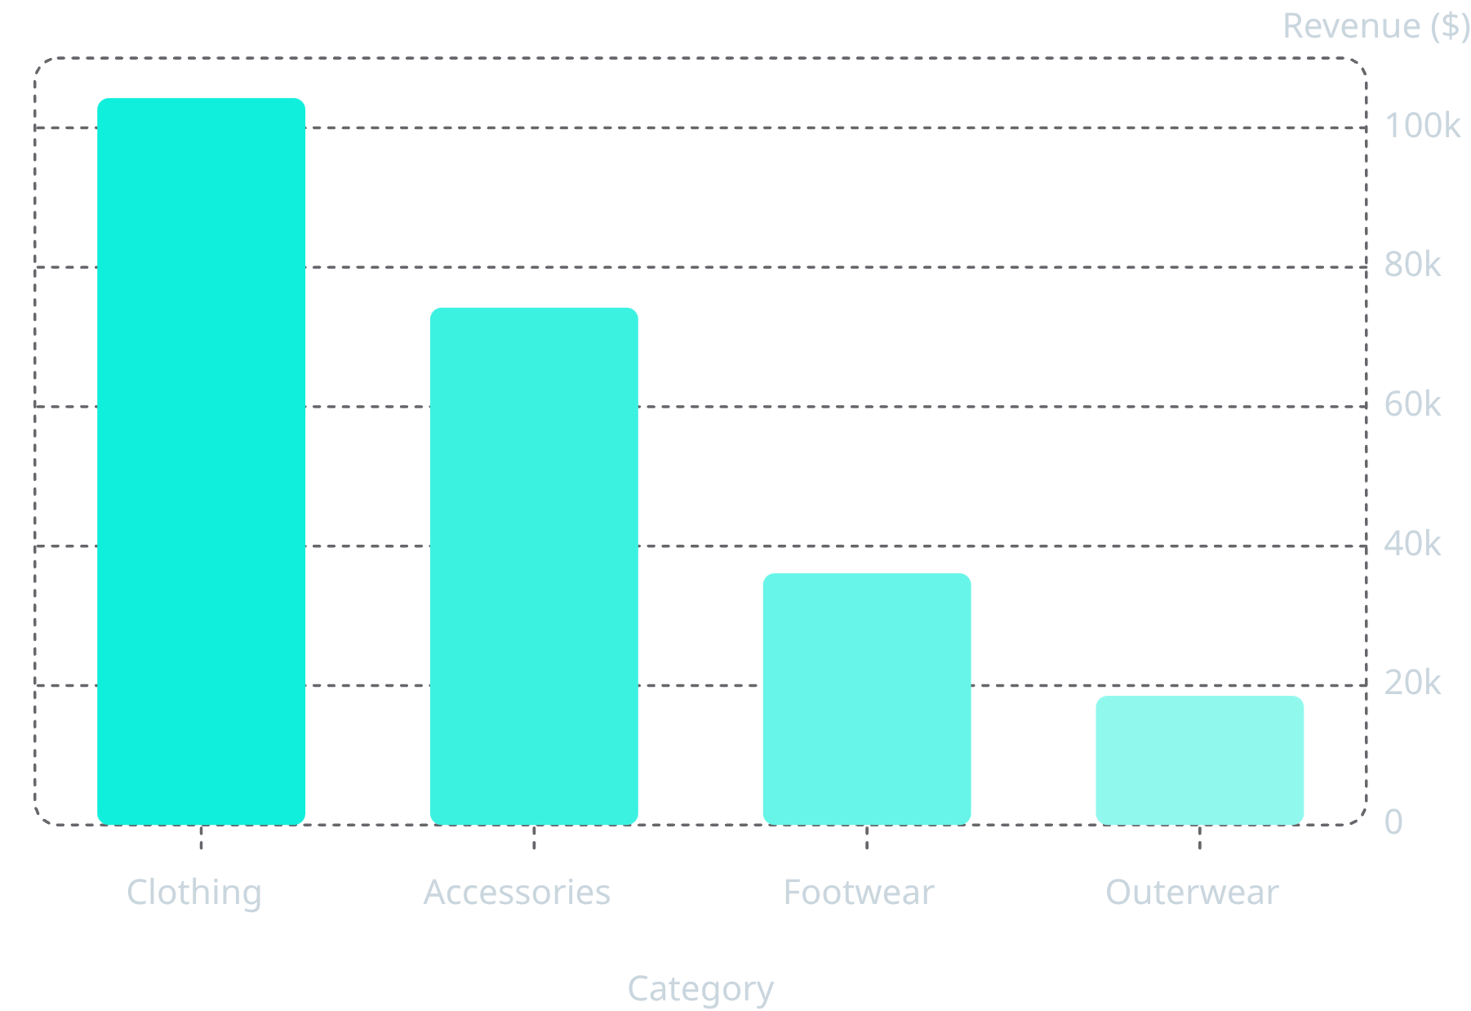
SECTION 3.3
Revenue by Category & Season
Clothing + Accessories
Fall Season
Strongest quarter at $60,018
76.5% of total revenue combined
Summer
Weakest at $55,777 — only ~7% gap

Slide 7

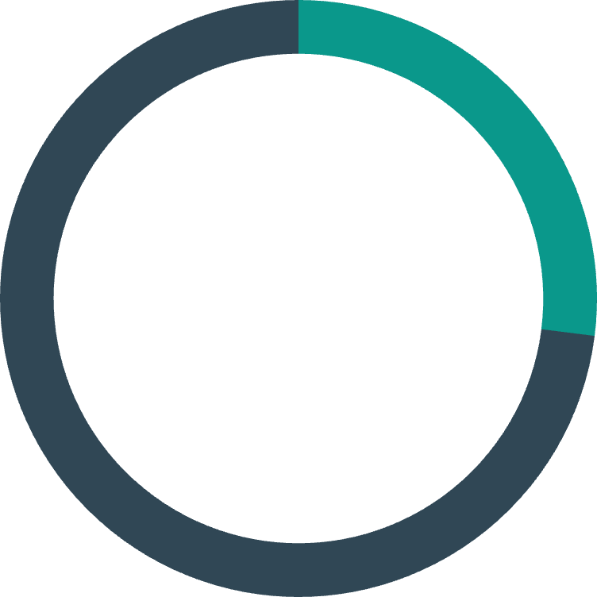

SECTION 3.2 & 3.4
Loyalty Signals & High-Frequency Segment
39.7%
27%
43%
Loyal Core
Subscribed
Discount Users
1,549 customers with 30+ prior purchases
1,053 customers actively subscribed
1,677 transactions used a discount
Subscribers and discount users show modestly deeper purchase history (+1.0 and +0.68 prior purchases respectively), but not larger baskets.
Discount users actually spend $0.85 less per transaction on average.
The 1,549 customers with 30+ purchases represent the company's largest single lever for retention — but their basket size ($60.03) is right at the company average.

Slide 8
SECTION 3.3
Fulfillment & Payment Insights
Standard and 2-Day Shipping post the highest satisfaction and repeat-purchase depth. Store Pickup is the weakest fulfillment path.
Shipping Type
Avg. Rating
Avg. Prior Purchases
Standard
3.82
26.23
Express
3.77
25.50
All six payment methods sit within a narrow 612–677 transaction band — no single point of checkout dependency.
Top 5 revenue states (Montana, Illinois, California, Idaho, Nevada) are within a $200–300 band — geography is dispersed.
2-Day Shipping
3.77
26.11
Next Day Air
3.72
24.77
Free Shipping
3.72
24.74
Store Pickup
3.71
24.80

Slide 9

SECTION 5
Key Findings
1
2
Spending is Uniform
Category Concentration
Avg. basket ($57–$61) and satisfaction (3.7–3.8) barely move across age, gender, subscription, or payment method.
Clothing (44.7%) and Accessories (31.8%) generate 76.5% of all revenue.
3
4
Loyalty Runs Deep but Flat
Soft Loyalty Lift
39.7% have 30+ prior purchases, but basket size is no higher than average — loyalty shows as frequency, not bigger baskets.
Subscribers and discount users show modestly higher purchase history, but not larger baskets.
5
6
Fulfillment Affects Satisfaction
Mild Seasonality
Standard & 2-Day Shipping rate highest; Store Pickup is lowest at 3.71.
~7% swing between Fall (strongest) and Summer (weakest) — enough to plan around.

Slide 10


SECTION 6
Business Recommendations
Protect Core Categories
Shift to Behavioral Targeting
Convert Non-Subscribers
Audit Discount ROI
Prioritize Clothing & Accessories in merchandising and campaign spend — they carry 76.5% of revenue.
73% aren't subscribed — a structured push to match subscriber engagement would grow repeat frequency.
Test whether promos drive incremental sales or subsidize purchases that would happen anyway.
Replace broad demographic offers with targeting based on purchase frequency and prior-purchase count.
Invest in Fulfillment
Build a Retention Track
Promote Standard & 2-Day Shipping; investigate Store Pickup satisfaction gap.
The 1,549 customers with 30+ purchases deserve loyalty perks, early access, and win-back campaigns.

